Slide 1

Financial Aficionados
WEALTH MANAGEMENT & INVESTMENTS
Presented By
Team KaChing!
Priyanka Daya | Fereshta Noori | Jagan Pandari | Yongjie Yu | Aishwarya Baalaji Rao

Slide 2

Research Question/Objectives
OUTLINE
Variables & Hypotheses
Research Method
Secondary Data Analysis
Our Data Analysis
Focus Group Findings
Survey Design
Results
Recommendations & Managerial Implications

Slide 3

RESEARCH OVERVIEW
The overall goal of this market research experiment is to evaluate the wealth management preferences of individuals in India and the U.S specifically with two asset types:
Stocks and Cryptocurrencies.

Slide 4

Research Questions/Objectives
QUESTION 1 : WHAT ASSET CLASSES DO INDIVIDUALS PREFER TO INVEST IN (STOCKS, CRYPTO, NONE)?
Objective 1: Determine customer preference and comfort level in investing in two different types of assets (stock vs cryptocurrencies).
QUESTION 2 : WHAT ARE INDIVIDUAL PREFERENCES WHEN IT COMES TO MANAGING THEIR INVESTMENT PORTFOLIO (I.E. ROBO ADVISOR, FINANCIAL ADVISOR, SELF-MANAGEMENT)?
Objective 2: Determine willingness to engage in self-management versus Robo-advisor versus utilizing a traditional advisor to aid in managing their investment.

Slide 5



HYPOTHESES
If Individuals have little to no financial literacy in stocks and crypto then they are more likely to utilize a traditional advisor or Robo-Advisor rather than self-managing their accounts.
Individuals from India are less likely to invest in crypto compared to individuals from the US.
In general, individuals from both India and the US are more likely to invest in stocks over crypto because they view stocks as a less risky investment compared to crypto.
Individuals with higher income levels are more likely to invest more in stocks and crypto compared to those with less disposable income.
Social influences are more likely to cause people to invest in stocks and crypto.
The rate of return is the most important factor when choosing a Robo-advisor.

Slide 6
INDEPENDENT VARIABLES
DEPENDANT VARIABLES
Assets types (stocks vs. cryptos)
Age
Financial literacy level
Brand Name (brokerages, Robo advisor apps)
Culture/Country differences
Social influence and impact
Gender
Income
Education level
Risk Aversion
1) Willingness to engage in investing in stocks or crypto
2) Willingness to engage in Robo-Advisors vs. Self-Managed Brokerage vs. Traditional Financial Advisor.

Slide 7

Research Methododology
Secondary Data Insights
Primary Data Collection
Exploratory Research - Focus Group
Descriptive Research - Survey
Data Analysis (Descriptives, Correlations, Regression, ANOVA)

Slide 8
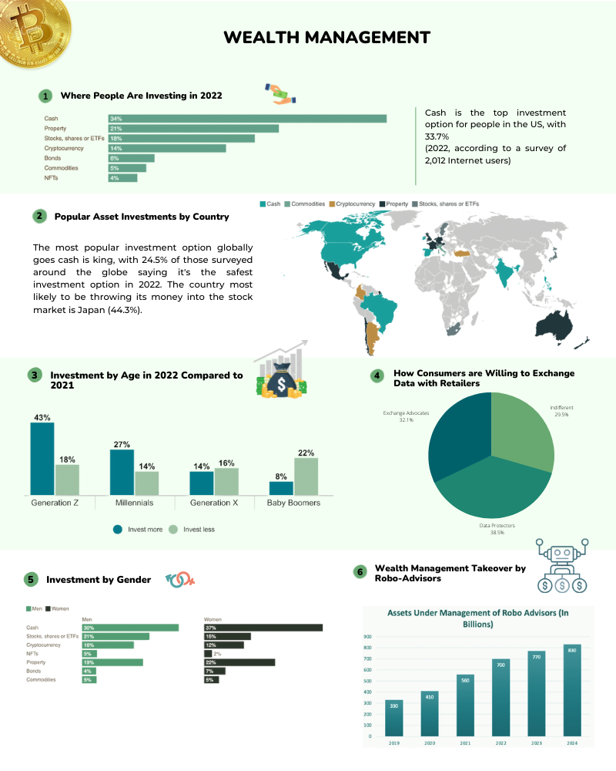
Infographic

Slide 9

Secondary Data Analysis
INVESTMENT ALLOCATION
People allocated 34% of their investments toward cash, 21% was allocated towards property, 18% towards stocks, shares, or ETFs, and 14% towards crypto.
INVESTMENT DEMOGRAPHICS
22% of women felt real estate was a better investment, while 21% of males felt more optimistic about stocks.
Change in investment habit from 2021-2022: 43% of Generation Z investing more and 27% of Millennials investing more compared to prior year.

Slide 10

Secondary Data Analysis
ROBO-ADVISOR POTENTIAL TAKE OVER
In 2019, there was about $330 billion worth of assets managed by Robo-advisors, and this is projected to significantly increase to $830 billion by 2024.

Slide 11

MOCK FOCUS GROUP INSIGHTS
Learned to encourage those that were more quiet to express their opinions allowing us to get diverse feedback.
Topics regarding wealth management, investments, and Robo-advisor is a new topic to many. We needed to create a short PowerPoint presentation to educate our participants, which allowed for more detailed and better responses from participants.
Needed to include a demographics survey to gain better insights regarding investments
Based on peer feedback, we decided to change the flow and structure of our discussion and narrow down our scope, which led to smoother final FGs.

Slide 12



Final Focus Group Findings
WILLINGNESS TO ENGAGE IN ROBO-ADVISORS
More experienced participants from both FGs were reluctant towards using a Robo-advisors.
Participants from India with low financial literacy were more open toward the idea of Robo-Advisors.
Participants from India were willing to pay anything lower than a traditional advisor
ASSET PREFERENCE
Indian participants were not comfortable with trying to invest in crypto because they felt it was not tangible and associated with something physical like stock.
American participants were more willing to try crypto investments. Indian participants is was too new, risky, way to volatile, and pure speculation.

Slide 13

FINAL FOCUS GROUP FINDINGS
Financially illiterate participants invested less in stocks and crypto. Both US and India participants stated they would invest more if they have more financial knowledge.
Both FGs had a common theme of social influence impacting whether or not they invested. Many started or tried investing because their friends and family were seeing a rate of return.

Slide 14

SURVEY DESIGN
Questions and answer choices were made based on focus group findings.
Ordinal, Nominal, Ratio, and Interval Questions
2 samples of at least 50 people each to ensure normality (n=50 India, n=50 US)

Slide 15

SURVEY DESIGN
Non-probability and river sampling
Increase reliability by asking similar questions that measure the same independent and dependent variables
Increased validity by doing prior screening and color-coding the question to ensure they were measuring the appropriate independent and dependent variables.

Slide 16



Survey Design & Learnings
SURVEY DESIGN
Intro and Consent Form (Advertise Incentive)
Simple Questions at beginning that introduces topics
Complex behaviors and preference questions regarding investing and wealth management
Demographics Surveys
Conclusion
LEARNINGS
Before administering our final survey we learned the importance of changing the order of our questions
Adding an introduction, consent form, and conclusion was imperative for our final survey
Imperative to do prior screening and ensure that participants fall in one of the two sample groups to increase validity.

Slide 17
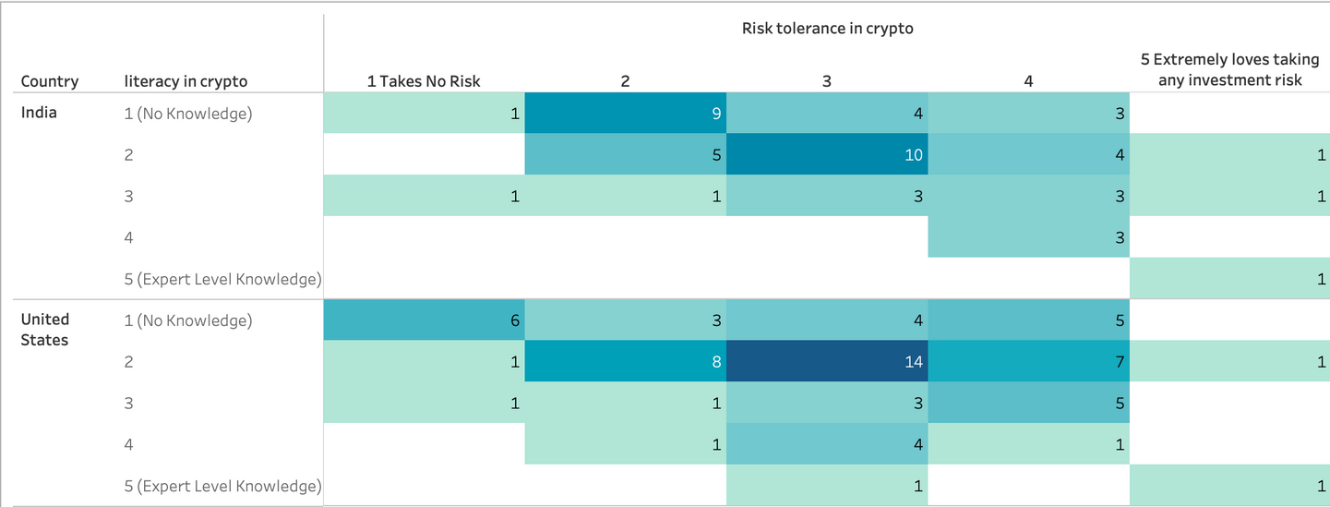
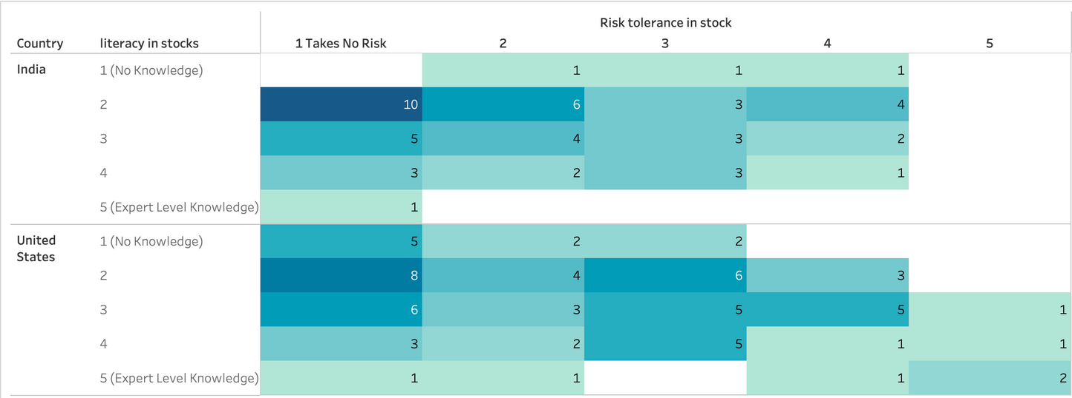
Primary Data Analysis - Risk Tolerance vs Financial Literacy
Risk Tolerance in Crypto:
Both groups of Indian and American participants had low to no knowledge of cryptocurrencies
But both had a moderate to low risk tolerance.
Risk Tolerance in Stocks:
Both groups had a tendency to have a lower overall risk tolerance for the stock market.
Notes:
Jagan
For the future - Would be interested in seeing what made people more wary of the stock market but less wary of the crypto market if the financial literacy was comparable

Slide 18

OUT OF THE FOLLOWING FACTORS, WHICH DO YOU BELIEVE INFLUENCES INVESTMENT DECISIONS THE MOST?
Friends
Social Media
Family
Strategy
Colleagues

Slide 19
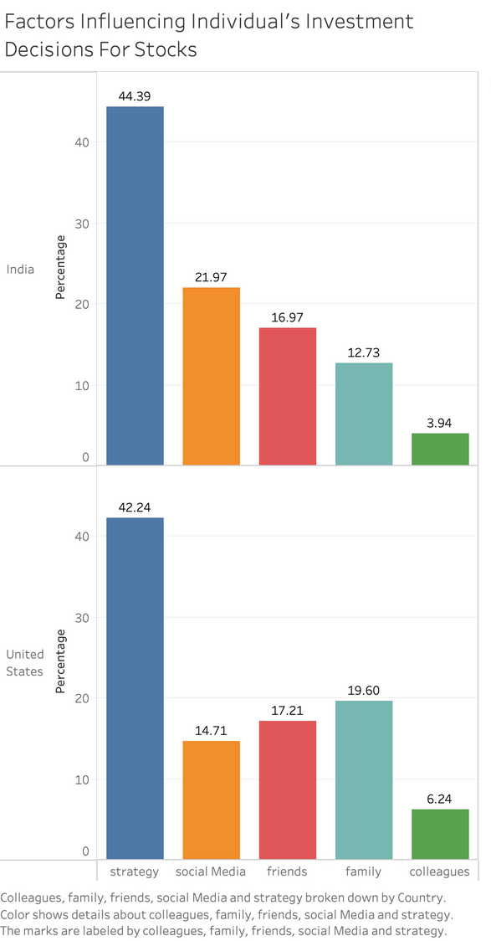
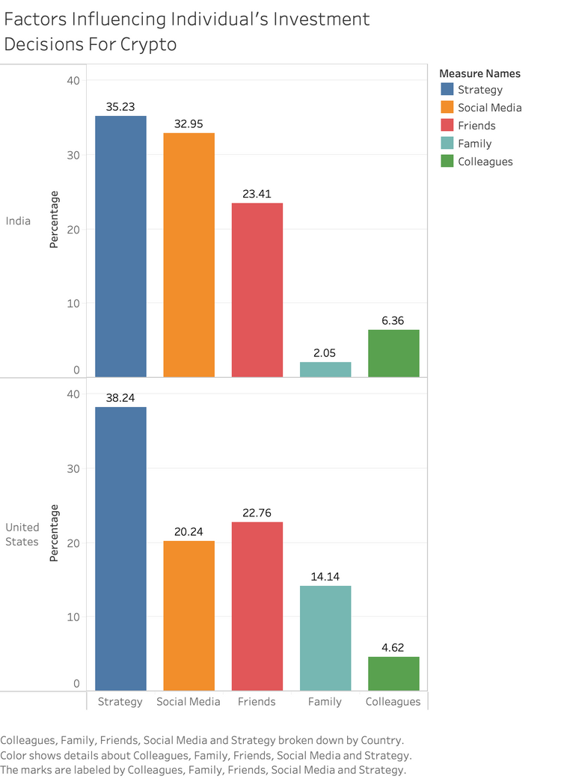
Primary Data Analysis - Individual Investment Desicions
Factors for Investing in Stocks:
Indians preferred looking at Social Media for their stock picks
Americans preferred the words of close family rather than Social Media
Factors for Investing in Crypto:
Indians preferred Social Media and Strategy near equally for crypto picks
Americans preferred the words of Friends second only to their overall strategy
Notes:
1. One thing that could be considered as a possible explanation for why Indians and Americans are different in the trust they place for stock investments, is that typically Americans have parents and grandparents with more generational stock market knowledge to guide their children with, however in India it's less common to see older generations investing in the stock market, and they rely on friends and social media the most.
2. Due to the new nature of cryptocurrency, Indians might look to the internet social media trends that shape their investment trends

Slide 20
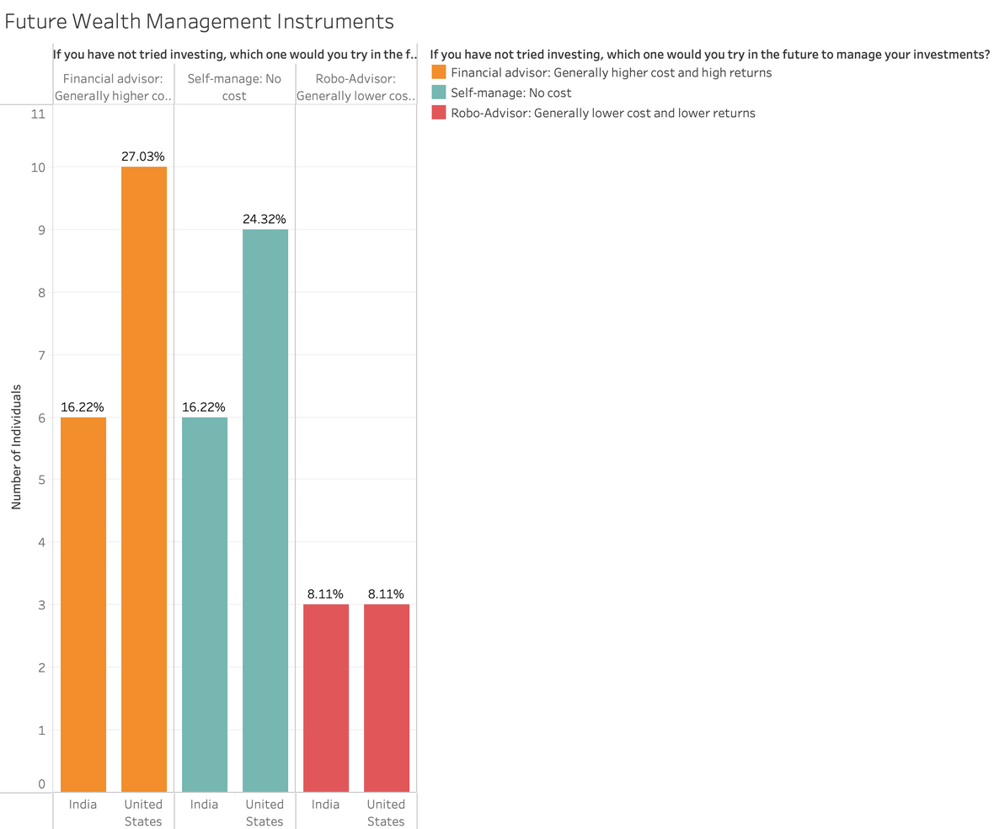
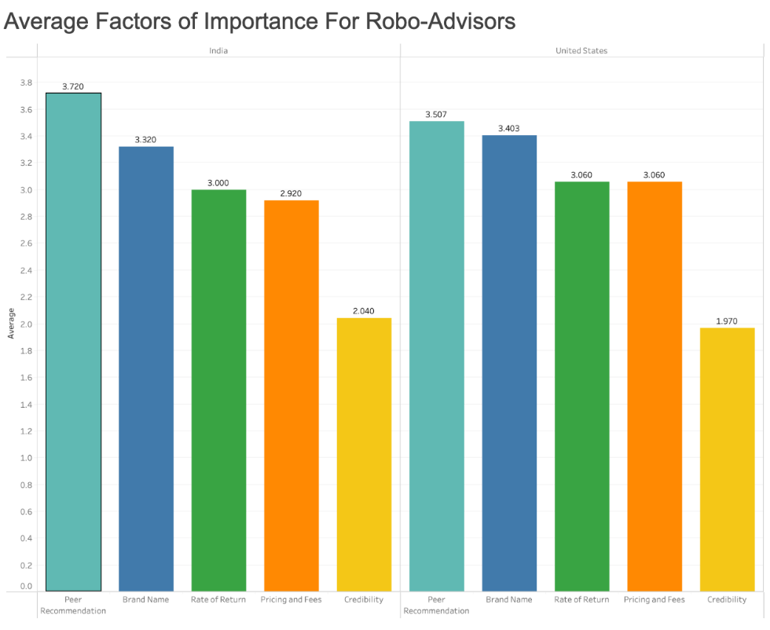
Primary Data Analysis - Robo-Advisors
Unsurprisingly both groups of people would not try to use robo-advisors in lieu of self-managing their funds or using a traditional financial advisor
However the aspects of a robo-advisor that are of top importance for both demographics:
Peer Recommendation and Brand Name

Slide 21
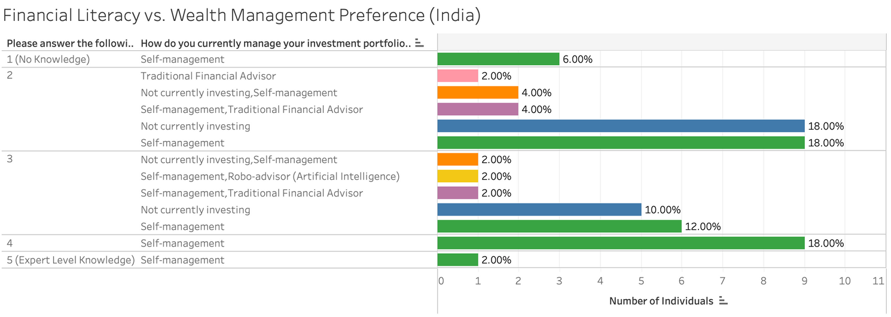
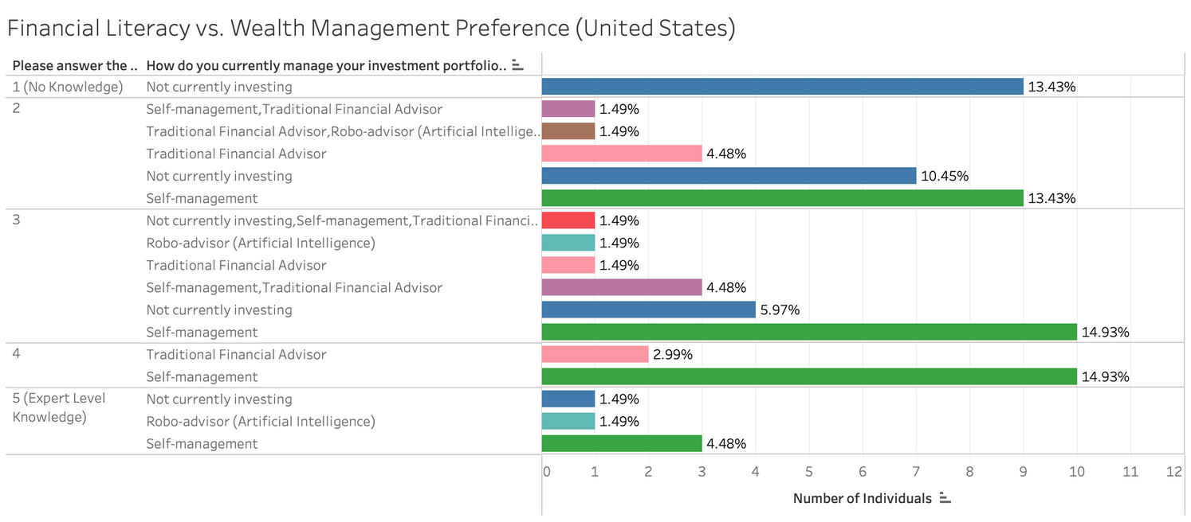
Primary Data Analysis - Financial Literacy vs. Wealth Management
India - 54% of participants were self-managing their funds, of where only 20% of people said they had a higher than average financial literacy in total
United States - 48% of individuals were self-managing their funds but 25% of people had a higher than average financial literacy
Notes:
While there was a significant difference between the two countries for how they managed their funds and the literacy each person had, the difference could be attributed to self-selection bias.

Slide 22
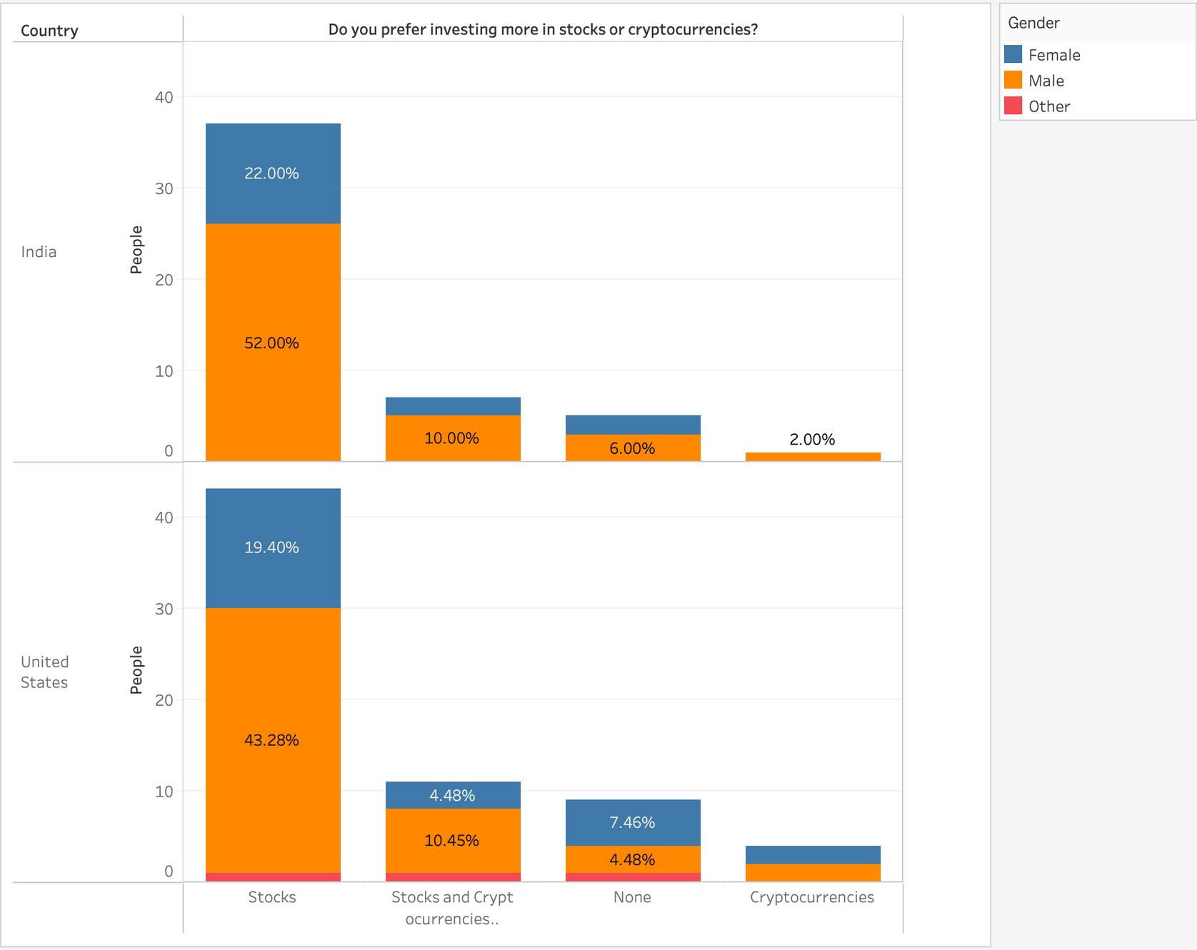

Slide 23

CORRELATION ANALYSIS STOCKS
Statistically significant correlation between the number of years in trading experience and the average amount of money invested in stocks for both India and US samples.
Positive moderate correlation (0.522 for US & 0.577 for India)
Statistical significance between risk tolerance and trading experience in stocks for US sample
CORRELATION ANALYSIS CRYPTO
Statistical significance between the number of years in trading experience and the average amount of money invested in crypto for both India and US samples.
Positive moderately high correlation (0.659 for US & 0.715 for India)
Statistical significance and positive moderate correlation between trading experience and risk tolerance in investing in crypto for US and India

Slide 24

WHAT DO YOU THINK ARE TWO OF THE MOST INFLUENCIAL FACTORS ON AMOUNT OF STOCKS INVESTMENT? POSITIVE OR NEGATIVE CORRELATION?

Slide 25
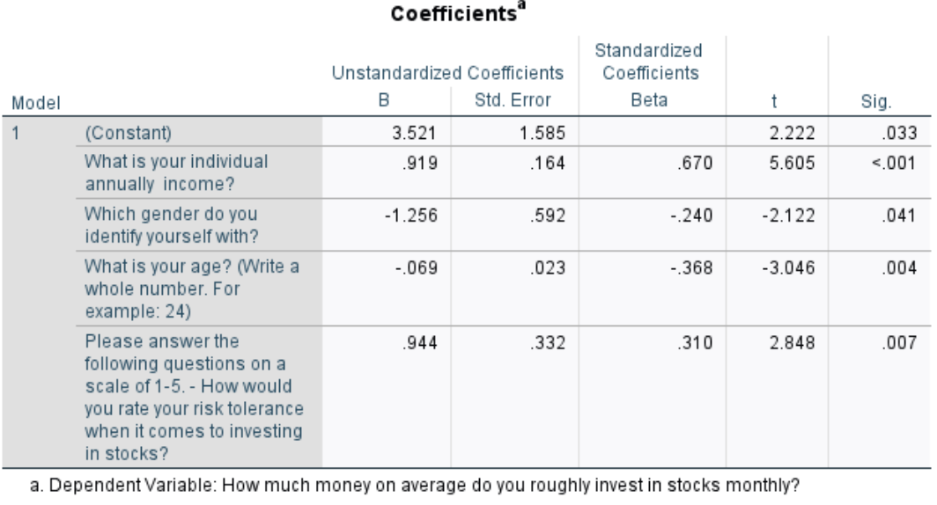
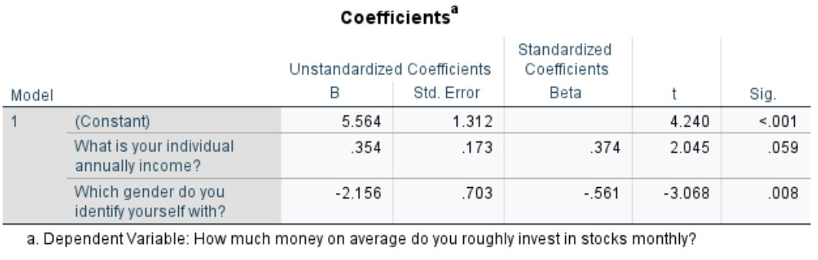
REGRESSION ANALYSIS
Factors influencing investment in stocks in USA:
Annual Income +
Risk Tolerance +
Gender -
Age -
Factors influencing Investment in Stocks in India:
Annual Income +
Gender -
Notes:
What do you think are two of the most signifacnt factors on stocks investment? positive or negative?

Slide 26
RESULTS & RECOMMENDATIONS
Preference for stock investment rather than cryptocurrencies
Distrust about Robo-advisors
Recommendations:
Brokerages should focus their advertisements on their most experience male customers.
American brokerages are encouraged to target younger people
we recommend marketing through micro-influencers for robo-advisors
we recommend Robo-advisors to be coded and advertised to invest more on stocks rather than cryptocurrencies
brokerages to offer online strategy courses to gain a competitive advantage.

Slide 27
THANK YOU

